Slide 1
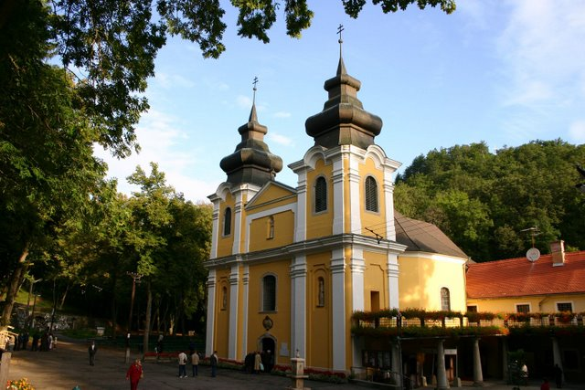
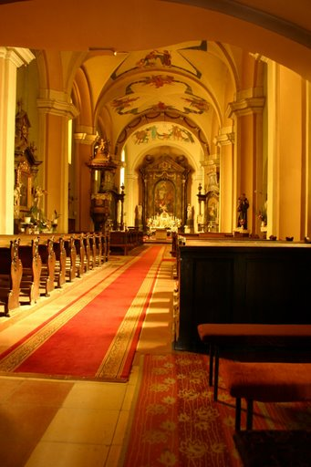
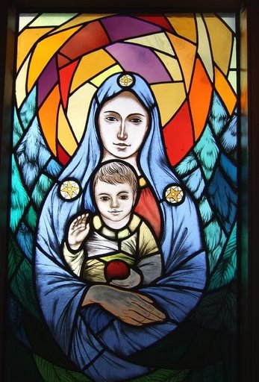
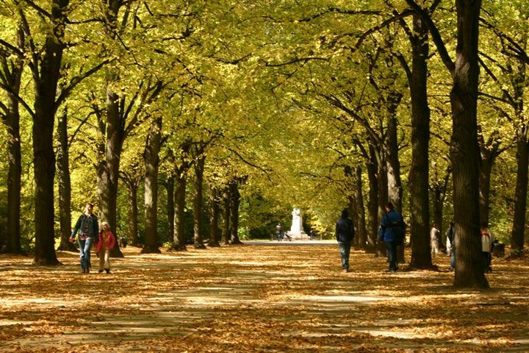
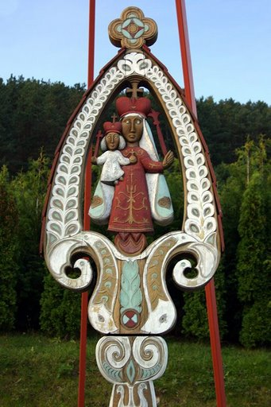
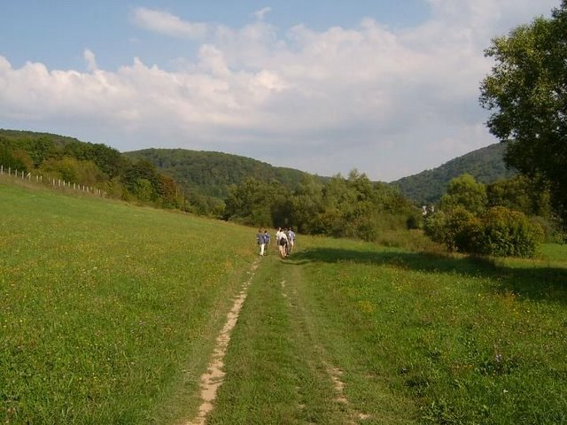
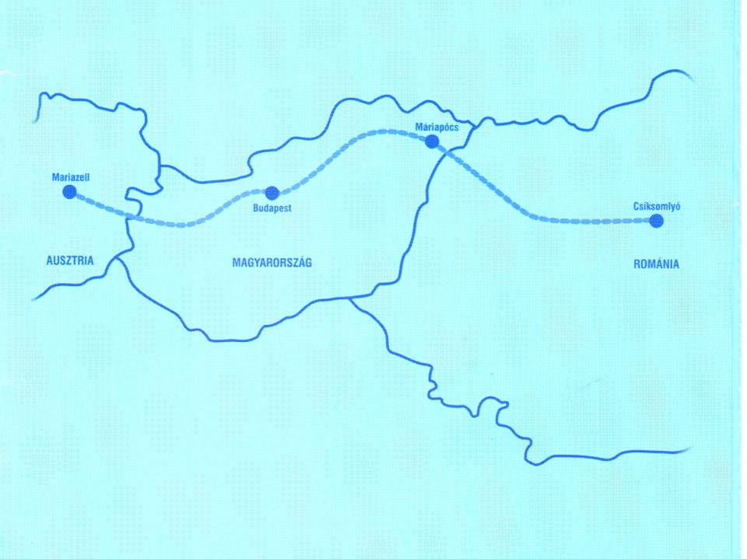
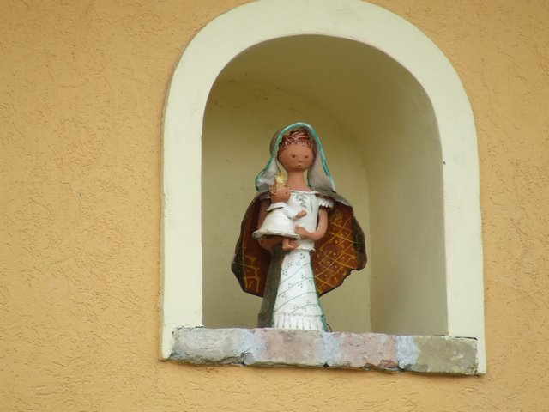
Via Maria
CEI Tourism Expert Meeting
Gödöllő, 6 June 2013
Association for Via Maria
Dr Tamás Szabó President
Zoltán Czégé – pilgrimage leader
Notes:
1
Association for Via Maria: Managing the route development as NGO.

Slide 2
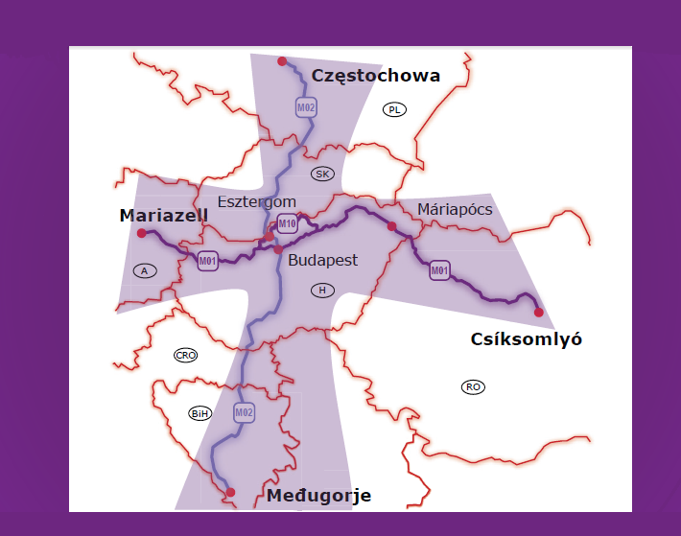
Notes:
East – West: Mariazell – Csíksomlyó
North – South: Czestochowa – Medugorje.
In the East – West route around 1000 pilgrims in 2013 (based on the 2012 and 2013 up to date figures). Almost exponential development.

Slide 3
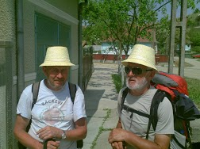
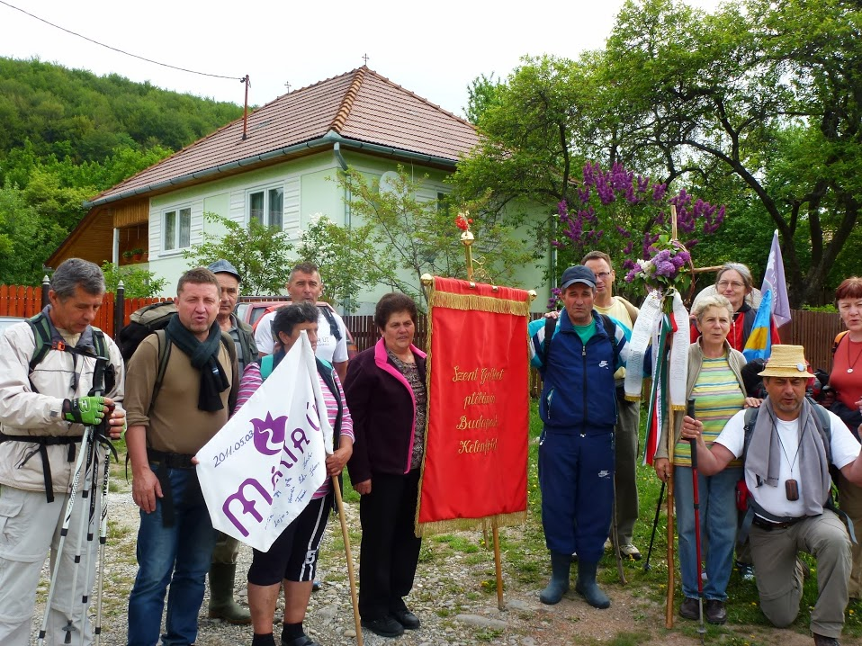
Experiences, goals
Creates peace: among people, nations and religions
„Must” become central european cultural &
pilgrimage route
Needs infrastructure development in the CE region(signs, accomodations)
Notes:
Understanding on the Route between pilgrims and local people.
Nr. 1 pilgrimage route between the participating countries.
East – West route in 90 % signed, infrastructure informations (accomodations, supply) in good developement. Maps, gps tracks, information handbooks available.
North – South: needs more cooperations in Poland, Croatia and Bosnia

